Slide 1



Welcome to
CS 345 Operating Systems
Memory Management, Ch 7 (16)

Slide 2

Tip #16: Optimized C
Capers Jones, an American specialist in software engineering methodologies examined 12,000 software projects and made two surprising discoveries:
Programmers write 325-750 lines of code per month.
The choice of programming language doesn’t influence that number.
How does that play out in real life?
Let’s say Tom and Bob are both asked to write a very simple web app that displays the number of widgets in stock in a warehouse. The number is stored in a database; all you have to do is display it to the user on a web page. Tom chooses a low-level language and Bob chooses a high-level language.
Tom’s status report one month into the project:
It went well. I wrote and tested about 500 lines of low-level code. The code initializes a connection to the database. By the end of next month, I might be able to send a query to the database. I’m devoting month 3 to reading the result from the database. In the following months I will write the code to display the result on the web page. Will be done in 6 months, 7 tops! Because I’m using an efficient low-level language, I expect my code (when done) to display the number to the user within 0.01 seconds!
Bob’s status report one month into the project:
It went well. I wrote and tested about 500 lines of high-level code. My code displays the number to the user within one second. The project is done.
Who do you think will be hired for the next project, Tom or Bob?
Addendum:
Tom’s code runs on an embedded firmware in a device the size of a dime that warehouse staff can wear on their lapel and that automatically updates wirelessly as they walk through the warehouse.
Maybe better to hire Tom.

Slide 3
Chapter 7 Learning Objectives
After studying this chapter, you should be able to:
Discuss the principal requirements for memory management.
Understand the reason for memory partitioning and explain the various techniques that are used.
Understand and explain the concept of paging.
Understand and explain the concept of segmentation.
Assess the relative advantages of paging and segmentation.
Summarize key security issues related to memory management.
Describe the concepts of loading and linking.

Slide 4
Memory Management Techniques
Fixed Partitioning
Divide memory into equal or unequal fixed size partitions at boot time
Dynamic Partitioning
Create partitions as programs loaded
Simple Paging
Divide memory into equal-size pages, load program into available pages
Simple Segmentation
Divide program into segments according to usage
Virtual-Memory Paging
Paging, but not all pages need to be in memory at one time
Virtual Memory Segmentation
Like simple segmentation, but not all segments need to be in memory at one time

Slide 5
Memory Management Techniques
Fixed Partitioning
Divide memory into partitions at boot time, partition sizes may be equal or unequal but don’t change.
Simple but has internal fragmentation.
8K
Operating System
8 M
First Fit
12K
Operating
System
Operating System
Dynamic Partitioning
Create partitions as programs loaded.
Avoids internal fragmentation, but must deal with external fragmentation.
Best Fit
8 M
22K
2 M
Allocate 12K
4 M
8 M
18K
6 M
Last allocated
block (14K)
New
Processes
8 M
Which is best?
First fit – simple and fast (liters front end).
Next fit – liters end resulting in fragmenting largest block of free memory.
Best fit – worse performer, guarantees smallest fragments, main memory quickly littered by blocks too small to satisfy memory allocation requests.
Worse fit – best performer as largest fragment remains.
8 M
8K
Allocated block
6K
Free block
8 M
8 M
Next Fit
14K
8 M
12 M
Worse Fit
36K

Slide 6
Buddy System
Tries to allow a variety of block sizes while avoiding excess fragmentation
Blocks generally are of size 2^{k}, for a suitable range of k
Initially, all memory is one block
All sizes are rounded up to 2^{s}
If a block of size 2^{s} is available, allocate it
Else find a block of size 2^{s+1} and split it in half to create two buddies
If two buddies are both free, combine them into a larger block
Largely replaced by paging
Seen in parallel systems and Unix kernel memory allocation

Slide 7
Address Translation

Slide 8
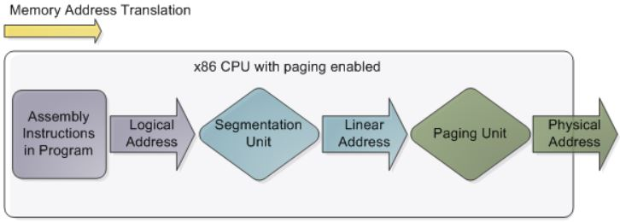
Address Types
Programmers refer to a memory address (address space) as the way to access a memory cell (addressability).
Logical (relative)
Reference to a memory location independent of the current assignment of data to physical memory
Consists of a segment and an offset
Linear (flat)
Memory appears to the program as a single contiguous address space directly addressable w/o paging schemes.
Mapped via segmentation
Physical (memory bus)
The absolute address or actual physical entity.
May require mapping via paging.

Slide 9
Hardware Support for Relocation
Logical address
Process Control
Block
Base Register
Adder
Physical
address
Program
Comparator
Interrupt to
operating system
Data / Stack
Bounds Register
Kernel Stack
Process image in
main memory

Slide 10
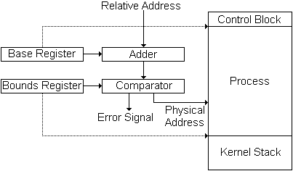
Base/Bounds Relocation
Base Register
Holds beginning physical address
Add to all program addresses
Bounds Register
Used to detect accesses beyond the end of the allocated memory
May have length instead of end address
Provides protection to system
Easy to move programs in memory
These values are set when the process is loaded and when the process is swapped in
Largely replaced by paging

Slide 11
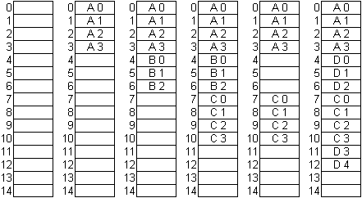
3. Simple Paging
Partition memory into small equal-size chunks and divide each process into the same size chunks
The chunks of a process are called pages and chunks of memory are called frames
Operating system maintains a page table for each process
contains the frame location
for each page in the process
memory address consist of a
page number and offset
within the page
Notes:
Use loose-leaf / bound book analogy
Linux runs at 2k page size

Slide 12
Simple Paging
Page size typically a power of 2 to simplify the paging hardware
Example (16-bit address, 1K pages)
010101 011011010
Top 6 bits (010101)= page #
Bottom 10 bits (011011010) = offset within page
Common sizes: 512 bytes, 1K, 4K
A
B
C
D
Free
0
-
7
4
13
1
-
8
5
14
2
-
9
6
3
10
11
12

Slide 13
Simple Paging
Frame
Number
0
A.0
0
0
0
7
13
1
A.1
1
1
1
8
14
2
A.2
2
2
2
9
Free Frame List
3
A.3
3
3
3
10
4
B.0
D.0
Process A
Process C
5
B.1
D.1
6
B.2
D.2
0
0
4
0
4
7
C.0
---
1
1
5
1
5
8
C.1
---
2
2
6
2
6
9
C.2
---
Process B
3
11
10
C.3
Process B
11
D.3
4
12
12
D.4
Process D
13
14

Slide 14
4. Simple Segmentation
Program views memory as a set of segments of varying sizes
Supports user view of memory
Easy to handle growing data structures
Easy to share libraries, memory
Privileges can be applied to a segment
Programs may use multiple segments
Implemented with segmentation tables
Array of base-limit register pairs
Beginning address (segment base)
Size (segment limit)
Status bits (Present, Modified, Accessed, Permission, Protection)

Slide 15
Simple Segmentation
A logical address consists of two parts: a segment identifier and an offset that specifies the relative address within the segment.
The segment identifier is a 16-bit field called the Segment Selector, while the offset is a 32-bit field.
To make it easy to retrieve segment selectors quickly, the processor provides segmentation registers whose only purpose is to hold Segment Selectors.
cs: points to a segment containing program instructions
ss: points to a segment containing the current program stack
ds: points to a segment containing global and static data
es: \
fs: points to a segment containing user data
gs: /
The cs register includes a 2-bit field
That specifies the Current Privilege
Level (CPL) of the CPU.

Slide 16
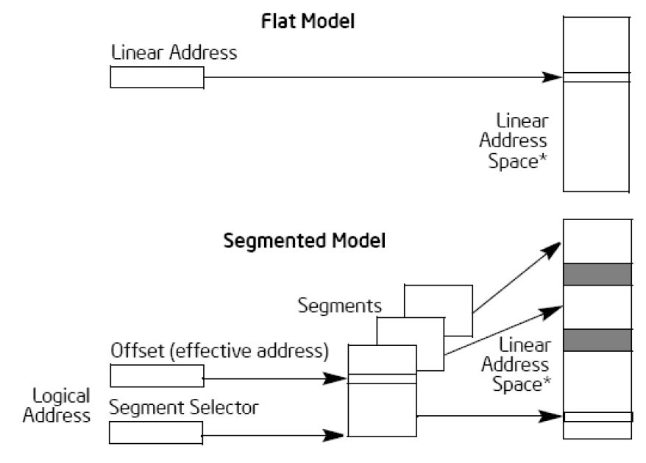
Segmentation/Paging
In Pentium systems
CPU generate logical addresses
Segmentation unit produces a linear address
Paging unit generates physical address in memory
(Equivalent to an MMU)
logical
address
linear
address
physical
address
CPU
Segmentation
Unit
Paging
Unit
Physical
Memory

Slide 17


Be Safe

